Slide 1

Kubernetes Bootcamp Building Cloudy Applications
Jungho Kim Jeevan Varughese

Slide 2
Hands-on Approach
Go Deep into core areas – the fundamentals
Go Broad in other areas, so you know what questions to ask
Maximize hands-on time
Deploy, reverse-engineer, break things, fix it
Guided examples
How to get help...
Kubernetes API Reference: https://v1-10.docs.kubernetes.io/docs/reference/generated/kubernetes-api/v1.10/
kubectl explain e.g. kubectl explain pods.spec, kubectl explain pods.spec.containers...
Ask us :-)

Slide 3
Objective By End of Day
You have hands-on exposure deploying a micro-service based application to K8S
You have an understanding of K8S architecture
You have an understanding of core K8S concepts and resources
You have an understanding of K8S tooling
You are an overview of the rapidly changing K8S space
You are excited about K8S and how it can change the way you build enterprise solutions, and get product to market faster!

Slide 4
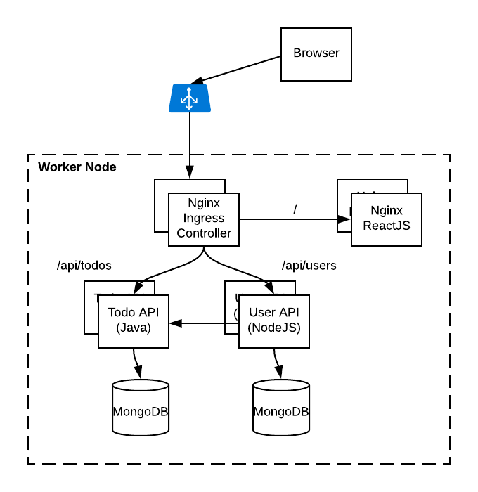
Todo Application
Simple Micro-service based application
ReactJS UI
Java Springboot TodoItem API
NodeJS User API
MongoDB for the database
Supports OpenID Connect/OAuth2 with Azure AD

Slide 5
Why Modernize Apps?

Slide 6
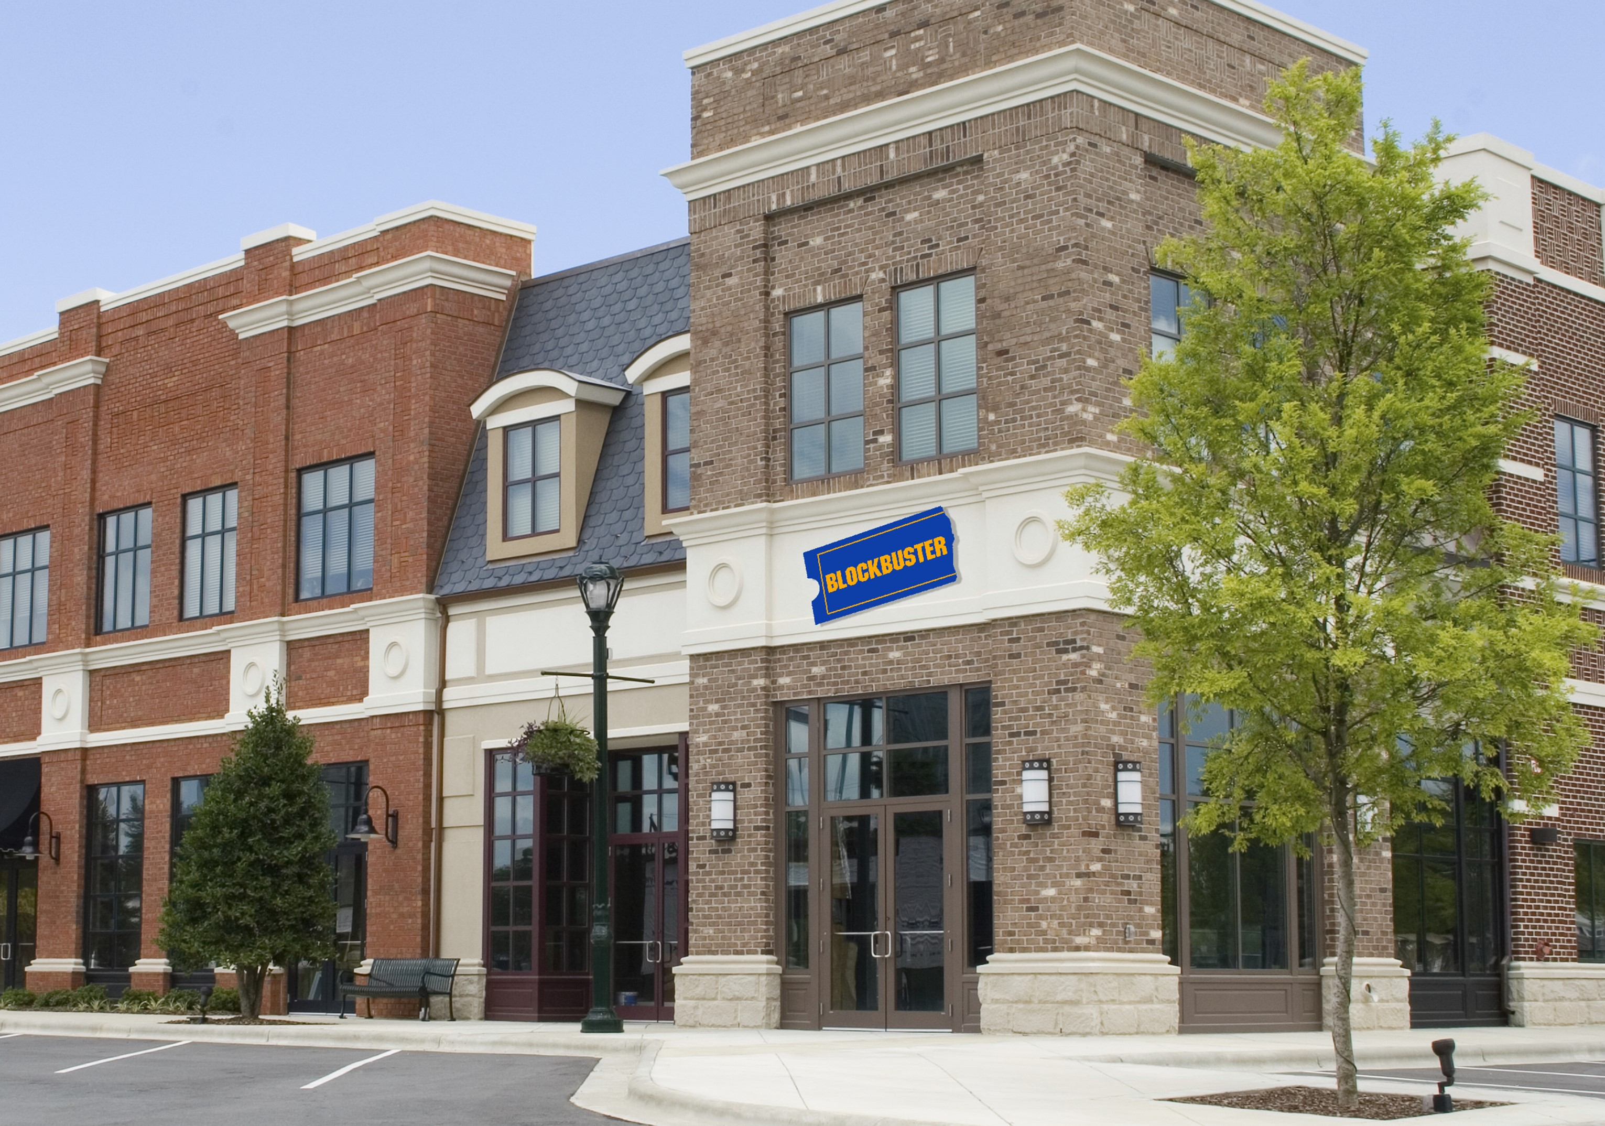








Slide 7
Our world is changing
Past
Long application cycles
Monolithic apps
Servers and VMs
Less data
Distinct infrastructure and operations teams
Today
Rapid innovation
Loosely-coupled apps and microservices
Serverless
Big Data
Service-focused DevOps teams
Servers
Services

Slide 8

Where do developers spend time…
Maintaining existing applications
“Fixing” existing applications
Adding features to existing applications
Fixing the feature someone else added to the existing applications
Building a new application
(maybe … if there’s time)

Slide 9

Where do application admins spend time…
Maintaining existing applications
Re-deploying new versions
of existing applications
Diagnosing issues with
existing applications
Troubleshooting issues from feature additions to the existing applications
Deploying a new application

Slide 10

Help customers free resources and work more efficiently by modernizing traditional applications

Slide 11


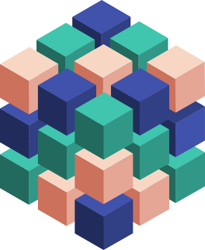
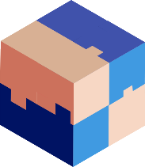



Ways to Modernize Applications
Lift & Shift
Modernize
Decompose
Transformed
Traditional application
Hosted as guest executables or containers in Kubernetes
Modernization by adding new microservices
Innovate by decomposing application into microservices
Transformed into microservices or new greenfield application
…You can stop at any stage

Slide 12


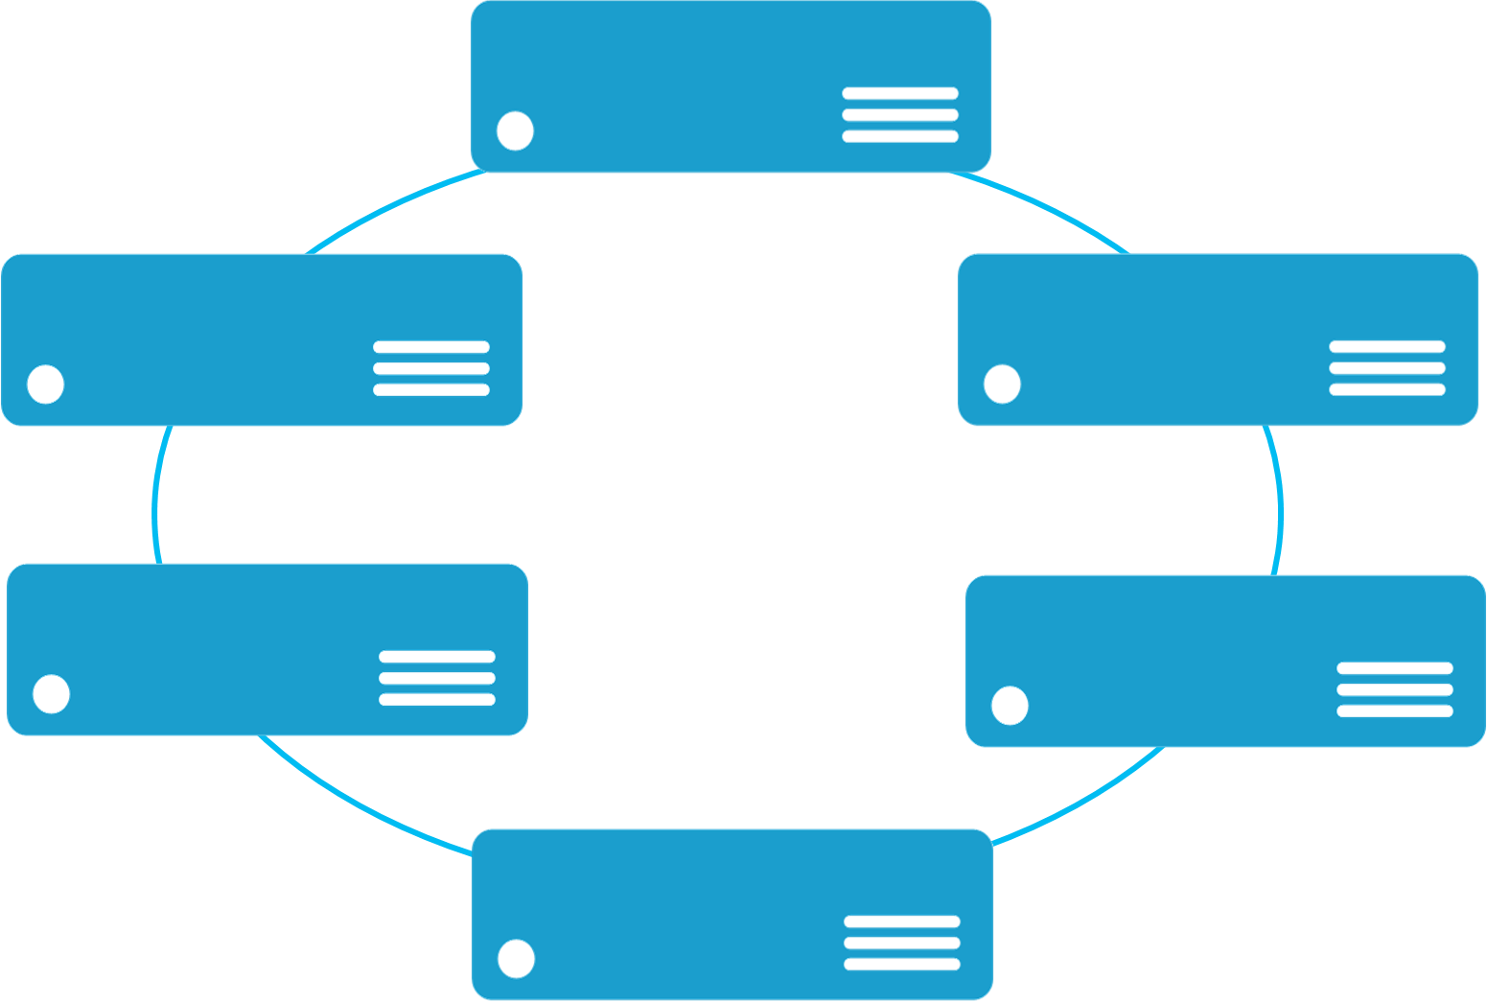


Monolithic application approach
Microservices application approach
A monolithic application has most of its functionality within a single process that is commonly componentized with libraries.
Monolith
A microservice application separates functionality into separate smaller services.
Microservices
Scales by cloning the app on multiple servers/VMs/Containers
Scales out by deploying each service independently creating instances of these services across servers/VMs/containers
State

Slide 13
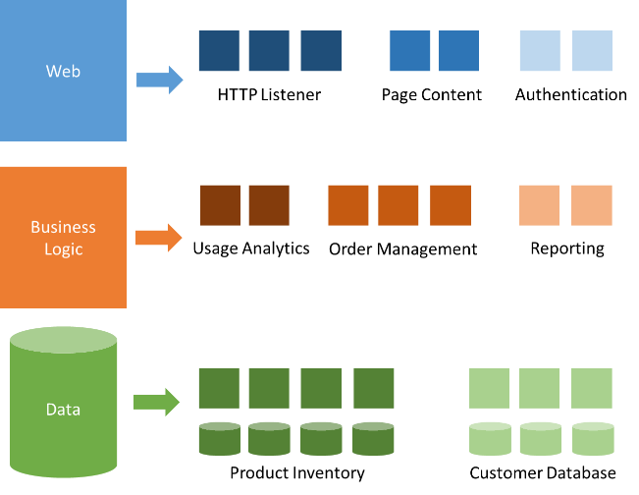
Modernization with microservices
Individually built and deployed
Small, independent services
Integrate using published API
Fine-grained, loosely coupled

Slide 14
Microservice architecture benefits
Scale Independently
Different Technology Stacks
Photo Share Service
Thumbnail Service
Photo Share Service node.js
Thumbnail Service .NET
Photo Share Service
Thumbnail Service
Photo Share Service
Thumbnail Service
Photo Share Service
Conflicting Dependencies
Independent Deployments
Photo Share Service
Photo Share Service V1
Thumbnail Service V1
SharedLib-v1
Thumbnail
Thumbnail Service V2
SharedLib-v7
Photo Share Service
Thumbnail Service
SharedLib-v1
SharedLib-v7

Slide 15
Microservices Benefits
Independent deployments
Enables continuous delivery
No downtime upgrades
Improved scale and resource utilization per service
Fault isolation
Security isolation
Services can be distributed across multiple servers or environments
Multiple languages / diversity
Smaller, focused teams
Code can be organized around business capabilities
Autonomous developer teams

Slide 16
Microservices – The Hard Part
Deployment is complex
Testing is difficult
Debugging is difficult
Monitoring/Logging is difficult
New service versions must support old/new API contracts
Distributed databases make transactions hard
Cluster and orchestration tools overhead
Distributed services adds more network communication
Increased network hops
Requires failure/recovery code
Need service discovery solution
Advanced DevOps capability: short-term pain for long-term gain

Slide 17
“Distributed apps are sufficiently complicated that they need to be flown by the instruments”

Slide 18
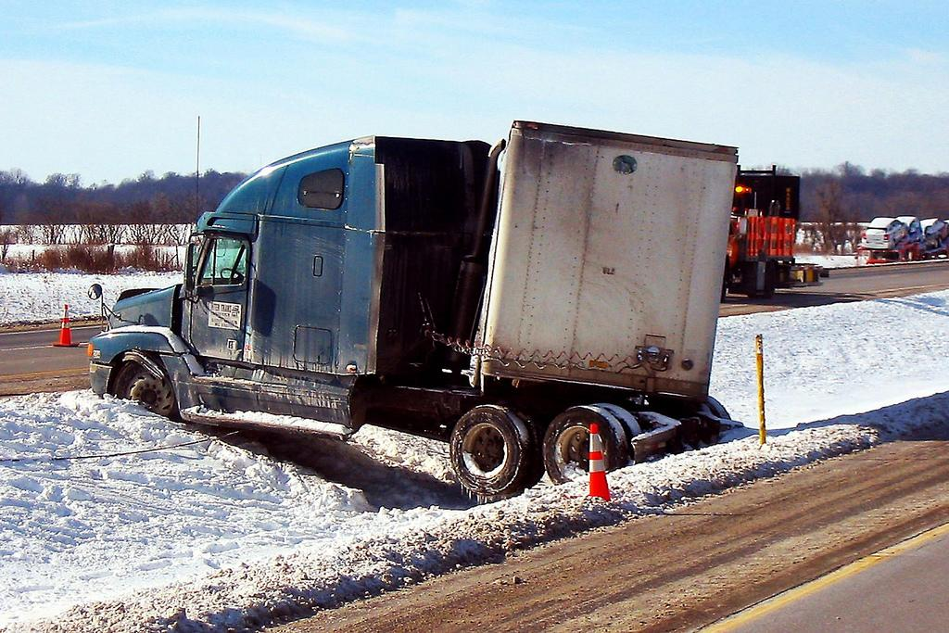


Slide 19
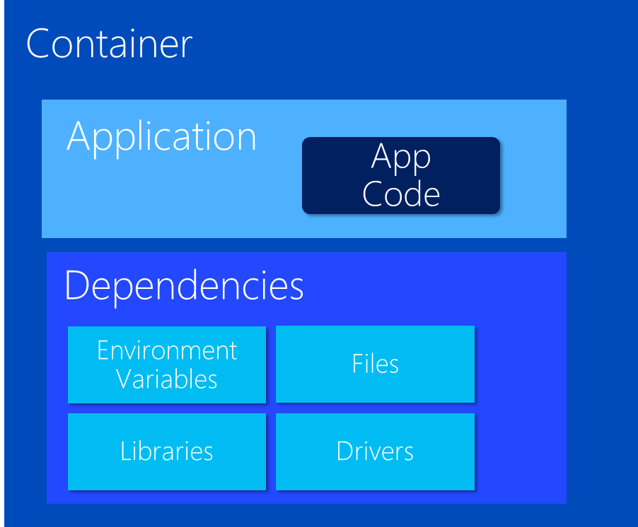
VM Host
VM Host
VM Host
VM Host
But things get
complicated quickly

Slide 20
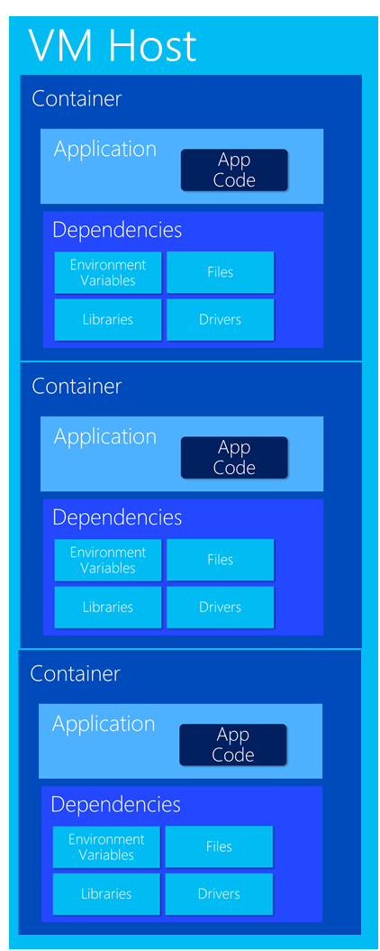
Very Quickly

Slide 21

What do cluster orchestrators do?
Provision
Security
Deploy (app / container)
Storage
Health Monitoring
Networking
Scaling
Service Discovery
Monitoring / Logging
Registry

Slide 22
Container Management at Scale
Cluster Management: deploy and manage cluster resources
Scheduling: where containers run
Lifecycle & Health: keep containers running despite failure
Naming & Discovery: where are my containers
Load Balancing: evenly distribute traffic
Scaling: make sets of containers elastic in number
Image repository: centralized, secure Docker container images
Continuous Delivery: CI/CD pipeline and workflow
Logging & Monitoring: track what’s happening in containers and cluster
Storage volumes: persistent data for containers

Slide 23
Orchestrator Ecosystem (Constantly Changing)
Cloud services
Azure Container Services (AKS, ACS)
Azure Service Fabric (ASF)
Amazon EC2 Container Services (ECS)
Google Kubernetes Engine (GKE)
Heroku
Tutum
Complete platforms
Kubernetes
Red Hat OpenShift (OCP)
Cloud Foundry
Mesosphere (Marathon)
Enterprise DC/OS
Docker Enterprise
Rancher
Low-level
Docker Swarm
CoreOS Fleet

Slide 24
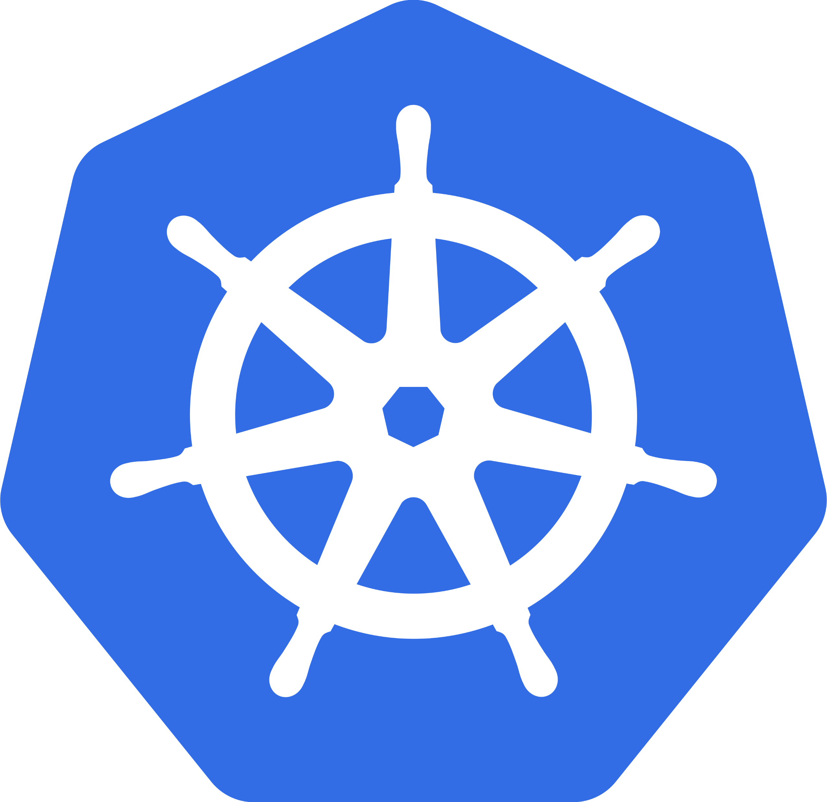
Why Kubernetes (K8s)?
Industry Momentum
It’s Microsoft’s Direction
It’s Docker’s Direction
It’s OCP’s Direction
It’s Cloud Foundry’s Direction
Brendan Burns
One of the Founders of K8s
Now works at MS heading up Container Strategies

Slide 25
What is Kubernetes?
History
Google open sourced borg. Google still actively involved, but less so every day
Schedules and runs application containers across a cluster of machines
Kubernetes v1.0 released on July 21, 2015. Joe Beda, Brendan Burns, & Craig McLuckie
Over 1,700 authors
Key features
Declarative infrastructure
Self-healing
Horizontal scaling
Automated rollouts and rollbacks
Service discovery and load balancing
Automatic binpacking
Storage orchestration
Secret and configuration management
Not a PaaS platform

Slide 26
Azure Container Service (AKS) Simplify the deployment, management, and operations of Kubernetes
Container hosting solution optimized for Azure
Azure-hosted control plane
Only pay for resource consumption
Automated upgrades, self-healing, easy scaling
Ease Kubernetes management with open source upstream portability
Notes:
AKS IS NOT “Azure Kubernetes Service”
Reference the history in ACS
Becoming a Kubernetes centric service. Docker and Mesos will eventually be more Azure Marketplace offerings

Slide 27
AKS Roadmap for GA
Automated Kubernetes upgrades
Self-healing Control Plane
etcd SSD backed, automated, H/A, backup/restore
Customized networking (Azure VNETs, CNI)
Cluster scaling
TLS everywhere. Backed by Azure KeyVault
RBAC and Azure AD integrated
Hybrid Clusters (futures)
Notes:
Some features are not available in preview

Slide 28
AKS Futures
Custom VNET support
Kubernetes RBAC with AAD Integration
kubectl OIDC Auth
Virtual Node Pools
Standard Compute
FPGA, GPU
Agent Pool Management
Self-healing
Auto-scaling
Hybrid Cluster: Linux and Windows Pools
Notes:
Some features are not available in preview

Slide 29
Azure Container Instance (ACI) Containers as a core Azure resource
Fastest and easiest way to run a container in the cloud
No VM management
Per-second billing based on resource requirements (CPU + Memory)
Deploy images from Docker Hub, Azure Container Registry, or any other Docker registry

Slide 30
The ACI model: billing
One-time charge for container creation: $0.0025
Per-second charge for CPU/memory requested:
1 vCPU core: $0.000013
1 GB memory: $0.000013
Examples:
Single container with 1 CPU/1 GB running for one month: $62.21
100 containers with 2 CPU/3 GB running for one hour each: $22.75

Slide 31
ACS Engine – Fully customized deployments
Generates ARM templates for Azure Container Service clusters
Golang tool - can be run in Docker or natively on Windows, OS X, Linux
Cluster defined by a JSON cluster definition file
Generates ARM template or directly deploys to Azure
Some of the customization options:
Choice of DC/OS, Kubernetes, or Swarm orchestrators
Multiple agent pools where each agent pool can specify:
standard or premium VM Sizes
node count
Virtual Machine ScaleSets or Availability Sets
Storage Account Disks or Managed Disks (under private preview)
Docker cluster sizes of 1200
Custom VNET

Slide 32
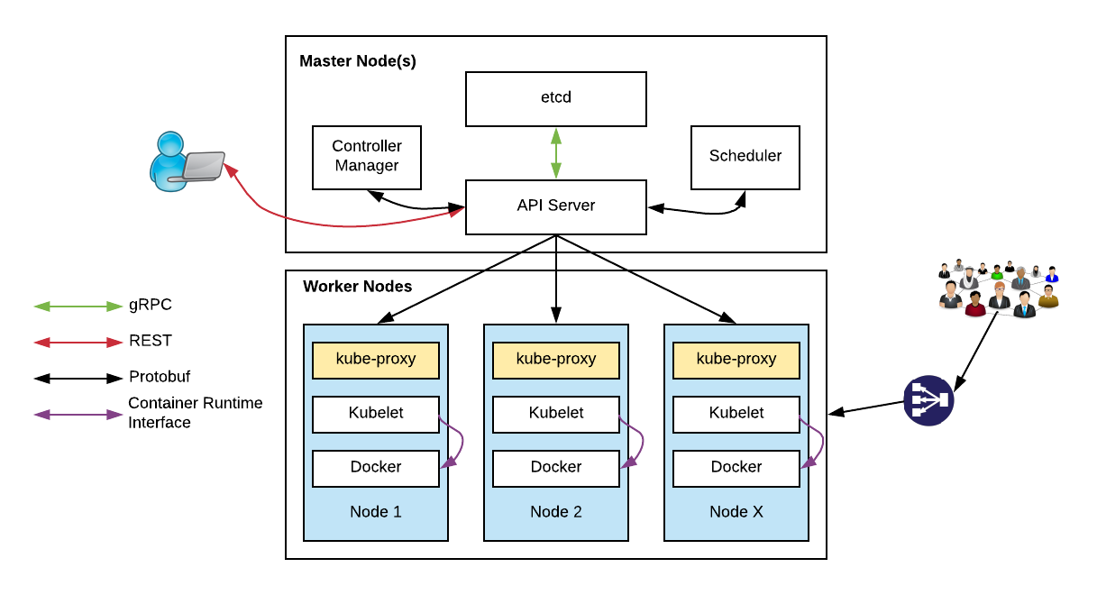
Kubernetes Architecture

Slide 33
Kubernetes Architecture Components
api-server
etcd
master components
controller-manager
scheduler
kubelet
kube-proxy
node components
container runtime (e.g. Docker, rkt)
dns

Slide 34
Master Components
api-server: Front-end control plane. Exposes API
etcd: Cluster database. Distributed, highly available
controller-manager. Runs controllers, eg. replication controller, deployment controller, and more
scheduler: assigns pods to nodes
Add-ons
DNS
Heapster. enables monitoring and performance analysis
Dashboard
Logging
Notes:
Api-server
Many different flags or switches to configure
REST interface
Etcd
Distributed, highly available key store
Written and maintained by CoreOS
Raft consensus algorithm
watches, keys, values
etcd3 standard beginning with Kubernetes 1.6
Scheduler: “Policy-rich, topology-aware, workload-specific function that significantly impacts availability, performance, and capacity”

Slide 35
Worker Node Components
kubelet:
Primary node agent
Watches and runs assigned pods
Executes health probes and reports status
Also key to “self-hosted” deployment of K8S where K8S is used to host K8S!!
kube-proxy: enables network services
docker: container engine (rkt supported experimentally)

Slide 36
kubectl: CLI to run commands against a Kubernetes cluster
Swiss Army Knife: run deployments, exec into containers, view logs, etc.
Syntax largely the same as docker
Pronounced “koob sea tee el”…
Or “koob cuddle”
Notes:
Borg: The first unified container-management system developed at Google
It was built to manage both long-running services and batch jobs

Slide 37
Kubernetes Resources
Pod
Deployment
Describes the “desired state” of your system
Components such as Controllers, the Scheduler, API Server, kubelet work together to put the system into the “desired state”
etcd stores this state
Service
ReplicaSet
Ingress
DaemonSet
Namespace
Job, CronJob
Secret, ConfigMap
and more!

Slide 38
Pods
Network
Pods are the smallest unit of deployment in K8S
Each pod gets an IP within the cluster address space
They can container 1 or more containers
The containers share a network namespace and can share volumes but have separate process namespace
Pod
Container A
Network Namespace
Container B
Volume 1
Volume 2

Slide 39
Services
Pods can come and go, so you need a stable IP to access your pods
Services and cluster DNS enables Service Discover in K8S
A service provides stable IP for clients
A service manages the dynamic endpoints that represent the Pods IP
Client
todo-api-service
selector =
app: todo-api
lookup
“todo-api-service”
to get stable IP
Cluster DNS
Todo API
Pod
Todo API
Pod
Todo API
Pod
Todo API
Pod
todo-api-pod
label =
app: todo-api

Slide 40
Services
5 types of services
ClusterIP
The default. Service IP is private to the cluster. Most of your services will be ClusterIP.
NodePort
Use when you have your own LoadBalancer
LoadBalancer
Cloud Provider provisions a LoadBalancer
ExternalName
Used to bind to external services (e.g. Your database that resides outside the K8S cluster)
Headless
A Service without an IP. Sometime, you want to know the IPs of the Pods, not the service, but you still want to do DNS lookup using a well-known name.

Slide 41
Deployments and Replicasets
Deployments enable you to do controlled rollouts of your pods
When you create a deployment, a replicaset is automatically created, the replicaset supervises many instances of your pods should be deployed
Deployments
ReplicaSets
Pods
Pods
Pods
kubectl scale --replicas=3 deployment/todo-api
kubectl rollout status deployment/todo-api
kubectl rollout undo deployment/todo-api

Slide 42
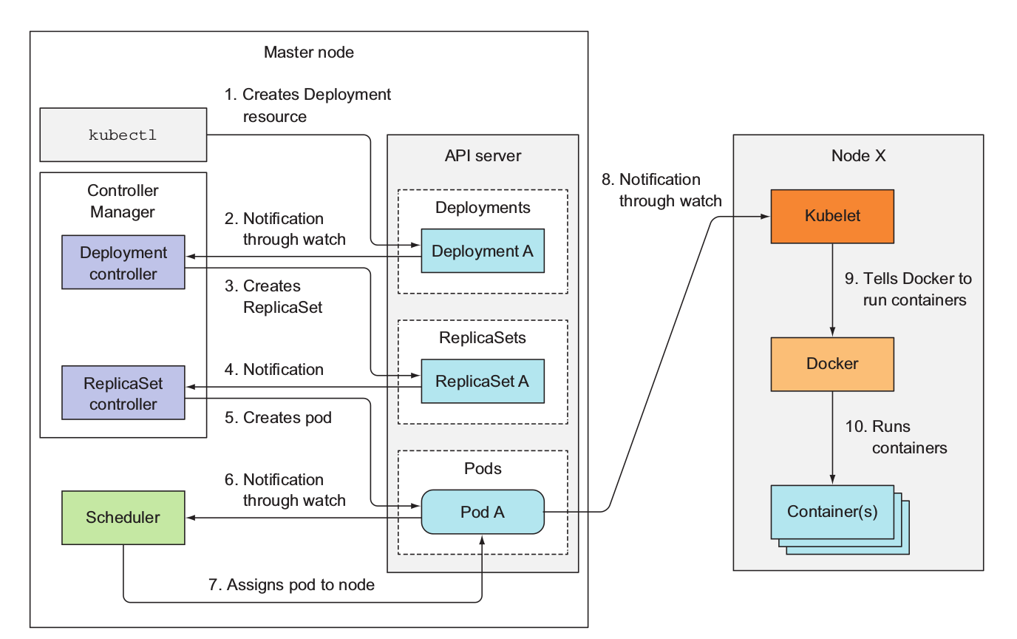
Deployment Events
From “Kubernetes in Action” by Manning

Slide 43
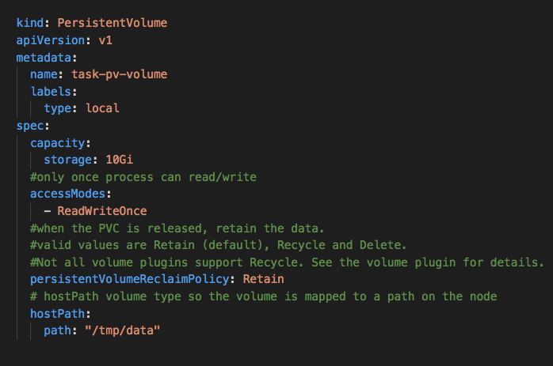
Persistent Volumes
Persistent Volumes are resources to specify how storage volumes are made available to pods
The containers in your pods mount these volumes to a path in their filesystem
K8S supports many volume types
https://kubernetes.io/docs/concepts/storage/volumes/

Slide 44
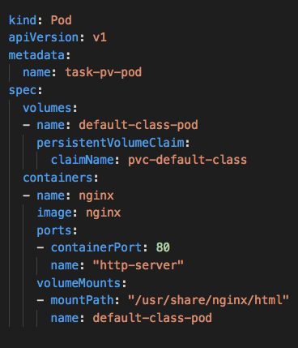
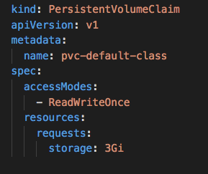
Persistent Volume Claims
PVC to PV is 1-to-1
Pod to PVC can be *-1 depending on access

Slide 45
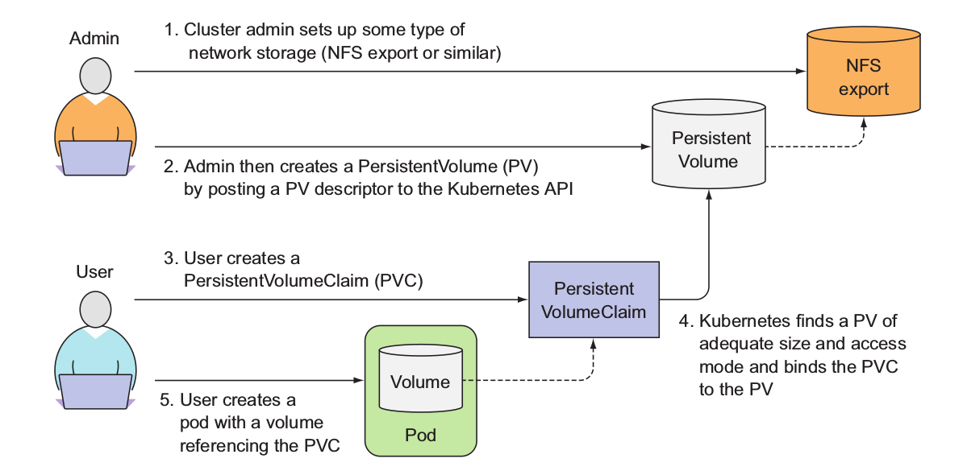
Persistent Volume Claims
From “Kubernetes in Action” by Manning

Slide 46
Static vs Dynamic Provisioning
If the cluster admin creates a PersistentVolume, this is static provisioning
The cluster admin needs to make decisions about the size of the volume
Persistent Volumes can be provisioned dynamically based on what is requested in a PersistentVolumeClaim
This requires StorageClasses

Slide 47
Storage Class
Storage classes are means for cluster admins to define different classes of storage for developers to use e.g. disk speed, capacity, etc
Developers can then request storage of a specific class in their PVC
If a storage class is not specified, and there is a default, then it will be used.
kubectl get storageclasses
NAME PROVISIONER
default (default) kubernetes.io/azure-disk
managed-premium kubernetes.io/azure-disk

Slide 48
Default Storage Class for AKS
apiVersion: storage.k8s.io/v1
kind: StorageClass
metadata:
annotations:
storageclass.beta.kubernetes.io/is-default-class: "true" ...
labels:
...
name: default
parameters:
kind: Managed
storageaccounttype: Standard_LRS
provisioner: kubernetes.io/azure-disk
reclaimPolicy: Delete

Slide 49
What user are you running as?
The process within containers by default, run as root
Much as possible, you do not want to run as root
Problem: Volumes are mounted with root ownership
Solution? Well, not so straight forward as it depends the volume type.
Let’s see the examples in k8s-bootcamp/storage

Slide 50
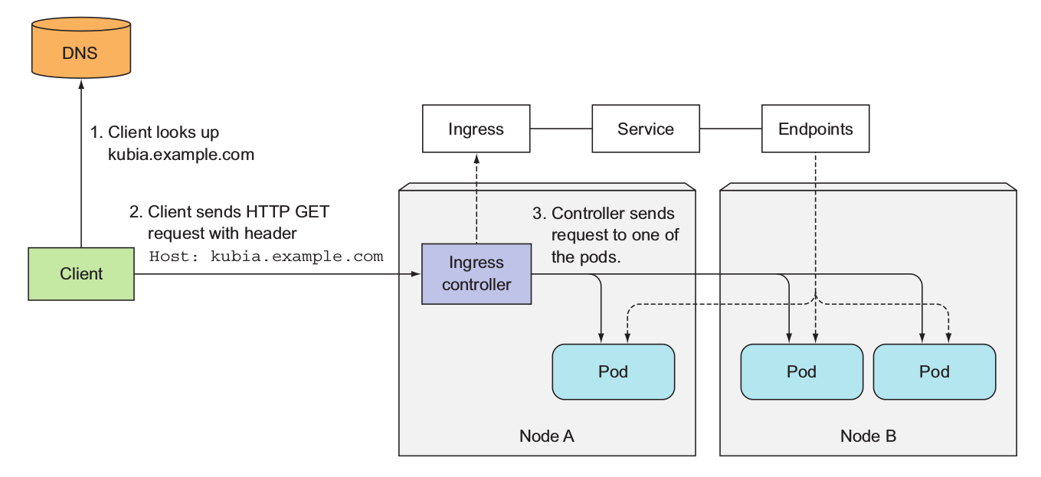
Ingress
From “Kubernetes in Action” by Manning

Slide 51
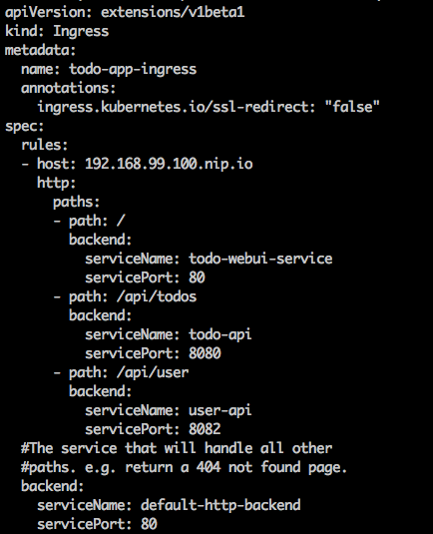
Ingress Rule

Slide 52
ConfigMaps and Secrets
12 Factor App #3
“Store config in the environment”
Two resources (very similar):
ConfigMap
Secrets (base64 encoded)
The config/secret can be exposed as:
Environment variables (use going forward)
Volumes (used for legacy apps e.g. existing spring application.properties)

Slide 53
DaemonSets
Often you will want to schedule one pod on every node
Such a pod is often called a system pod because they perform system specific duties
For example,
Log aggregation
Monitoring
Security Event Monitoring
Etc
See k8s-bootcamp/daemonsets

Slide 54
Jobs
Jobs are those processes that run to completion
They can be scheduled (with CronJobs)
They can be parallelized
They either complete successfully or not
They can be configured to ”try again” up to XX times
See k8s-bootcamp/jobs

Slide 55
StatefulSets
Similar to deployments in that you can specify replicas and can do controlled upgrades and rollbacks
Different in that each pod has identity and the PersistentVolumeClaims have identity
Example:
MySQL cluster has a master node and replicated slaves
The master is read/write, the slaves are read-only
See k8s-bootcamp/statefulsets

Slide 56
Securing Your Cluster
There are many considerations that need to be made to secure you cluster. I will be talking about:
Authn/Authr
Pod Security Policies
Network Policies
You also need to deal with rolling over keys, secret management, auditing, quickly revoking access, security event monitoring, encryption at rest, process, and more…
See k8s-bootcamp/security

Slide 57
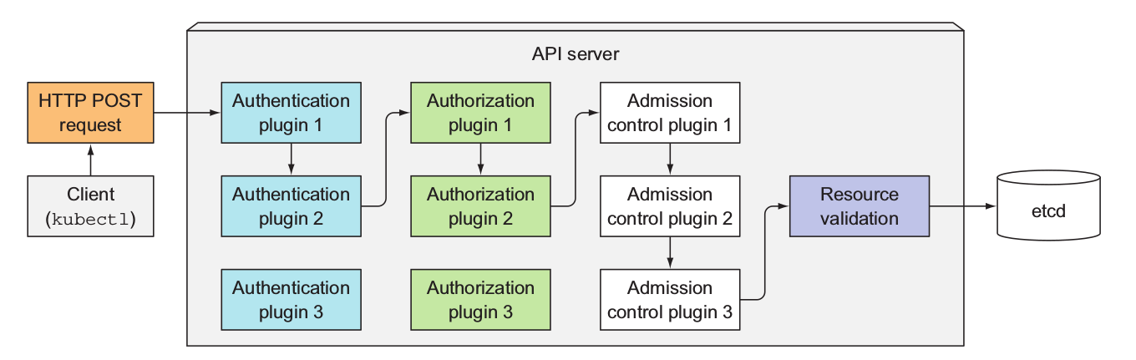
Authn/Authr
Authr decision based on a set of attributes:
apigroup, resource, verb, subject
Modules executed in order, short-circuit upon successful authentication/authorization
From “Kubernetes in Action” by Manning

Slide 58
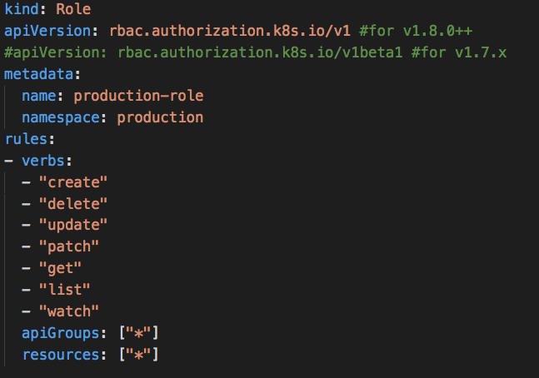
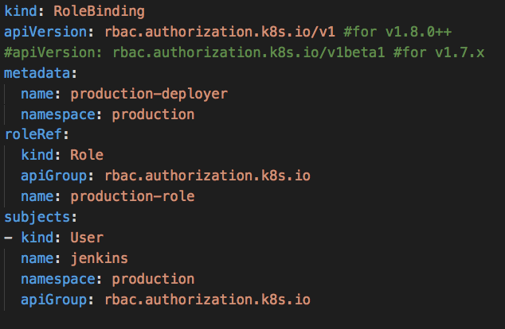
RBAC
Roles define permissions
RoleBindings grant permissions to subject at a namespace level

Slide 59
Advanced Scheduling
The kube-scheduler is very smart, it general, it does what you need
However, there are scenarios where you need more fine-grained control
Example:
You want dedicated nodes for ElasticSearch (because they need fast disks and are resource-intensive)
You want dedicated nodes for you database cluster, as it simplifies backing up the data
See k8s-bootcamp/scheduling

Slide 60
Monitoring and Log Aggregation
There are many, many tools to perform monitoring, log-aggregation on K8S
Monitoring is having visibility (real-time as possible) on resource usage, network traffic, etc on your cluster. You want to monitor, containers, pods, nodes, storage, network, latency, etc
Log Aggregation is bringing all relevant logs (both system and application) together, indexing them so that that they are quickly searchable down to the finest level of granularity possible.

Slide 61
Monitoring and Log Aggregation
Some tools:
Prometheus for scraping monitoring data, Grafana for visualization
FileBeat/LogStash/Fluentd to aggregate/index logs to be searchable by ElasticSearch, Kibana for visualization
Azure OMS with Log Analytics
Sysdig
DataDog
Splunk
Many more!!!

Slide 62
Extending Kubernetes
K8S has been designed from the outset to be extendible
Many extension points (See http://bit.ly/2pugymE)
We will cover the following:
Custom Resource Definitions
Aggregated APIs
Service Catalog (Open Service Broker API)
See k8s-bootcamp/extending-k8s

Slide 63
Service-Meshes
Service meshes have been around for a few years and it is a rapidly moving space and important for large-scale micro-services deployments
Problems that they solve:
Distributed tracing of requests
Fine grained security policy
More intelligent routing
Circuit breakers in the network, not in the code
See k8s-bootcamp/service-mesh

Slide 64
Cluster Administration
There are many considerations when it comes to administrating a cluster. I will cover:
CNI (Container Network Interface)
LimitRanges
ResourceQuotas
Upgrading the Cluster
Backing up your cluster
See k8s-bootcamp/cluster-admin

Slide 65
Options for Deploying K8S On-Premise
Kubernetes is very flexible, and there are many options to deploy Kubernetes on-premise
Let’s cover various options and considerations
See k8s-bootcamp/on-premise

Slide 66
Openshift
Kubernetes distribution from Redhat
Positioned as a “PaaS”
Extends core Kubernetes with additional API primitives and controllers to provide Developer and Operations workflows
Provides the ‘oc’ cli that extends ‘kubectl’ with Openshift specific commands

Slide 67
Openshift Versions
Multiple versions:
Openshift Online – Redhat hosted (AWS), multi-tenant
Openshift Dedicated – Redhat hosted (AWS), single-tenant
Openshift Container Platform – Deploy anywhere, Redhat supported
Openshift Origin – Open-source, upstream project for all other Openshift versions, Redhat does not provide support
Managed Openshift on Azure – Redhat and Microsoft support currently in Private Preview (https://azure.microsoft.com/en-ca/blog/openshift-on-azure-the-easiest-fully-managed-openshift-in-the-cloud/)
Redhat supported versions have to use RHEL or RHEL Atomic as the master/worker node OS.
Origin supports CentOS and Ubuntu (flaky)

Slide 68
Openshift API Resources
Openshift adds many additional API resources to the core Kubernetes primitives
Some overlap and therefore, you need to make a decision which one to use
Others provide an abstraction over underlying K8S resources
Others are new concepts that do not have similar capabilities in K8S e.g. BuildConfig, ImageStream
To see all the Openshift API resources see: https://docs.okd.io/latest/rest_api/index.html
Openshift also introduces their own custom controllers to consume these API resources to reconcile the ”current state” with the “desired state”

Slide 69
Key Openshift Resources
Project
essentially analogous to K8S namespaces
BuildConfig
describes how inputs are transformed into deployable artefacts
Supports multiple ”strategies” such as S2I (source to image), Docker, Pipeline (Jenkins), Custom
DeploymentConfig
Analogous to K8S Deployment resource (Note, Openshift uses ReplicationControllers vs the Deployment/Replicaset model of Kubernetes)
Specify replicas, update strategy, etc
Supports “triggers” to redeploy based on change to another resource

Slide 70
Key Openshift Resources
ImageStream
Essentially a virtual pointer to Docker images
Supports referencing different versions of a docker image
Referenced within BuildConfig and DeploymentConfig as image repositories
Changing an ImageStream can trigger builds and deployments
Route
Similar to K8S ingress rules, used to specify routing rules consumed by “Routers”
Default HAProxy router is deployed as a Pod on the cluster
Supports sharding, blue/green, canary, A/B testing deployment scenarios

Slide 71
Key Openshift Resources
SecurityContextConstraints
Similar to PodSecurityPolicies
Template
A parameterized template to deploy multiple API resources that make up a solution
Used to specify service catalog components in the Web Console
Helm and helm charts are much more powerful
User/Identity/Group
K8S does not have a notion of a User. K8S supports multiple identity stores and maps identity (via multiple approaches) to RBAC policy. Note, Openshift does use K8S RBAC model.

Slide 72
DevOps & CI / CD

Slide 73
DevOps Practices Arrive
Developers: Test, Build, Code, Plan
Operations: Monitor, Release, Deploy, Operate
DevOps Features
Speed of application delivery/updates
Faster time to value
Repeatable/consistent
Automated testing
Traceability of process
Applying developer patterns to infrastructure
Infrastructure as code
Ops teams embracing source control
Centralized monitoring, logging, debugging
CI / CD – key aspect of quality DevOps

Slide 74
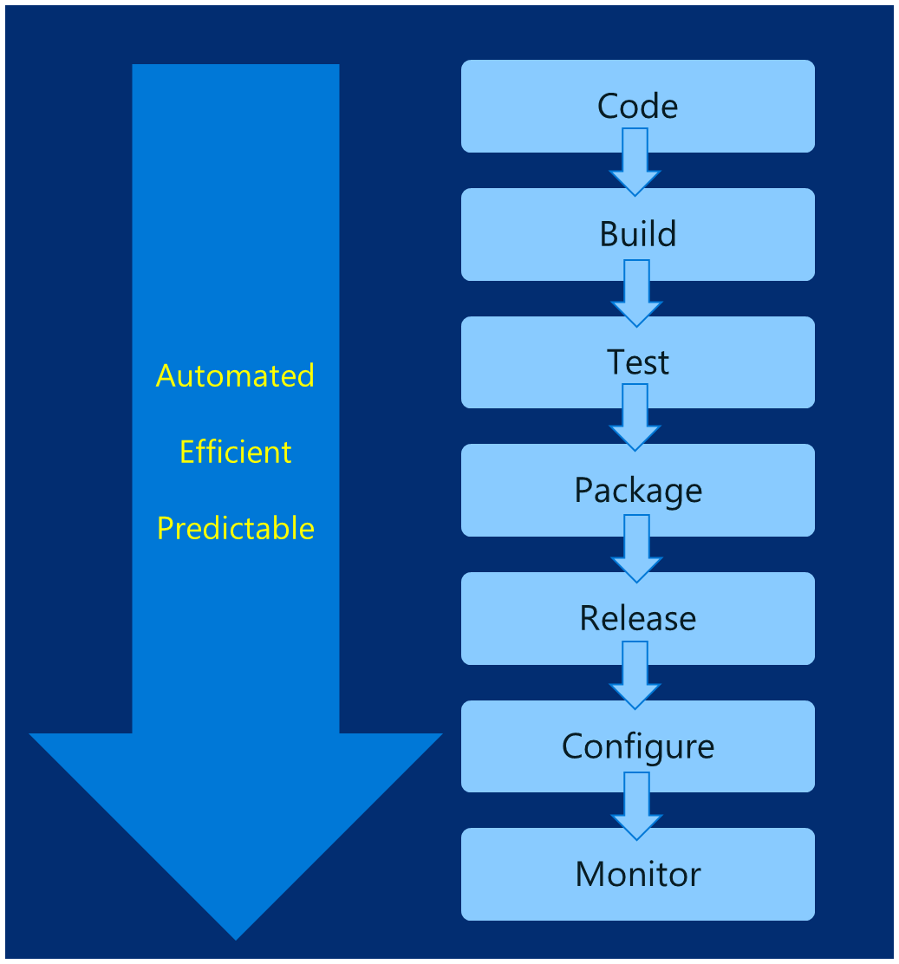
DevOps – Why you care
Deploy 200 times more frequently
Go from code check-in to production 2,555 times faster
Recover from failure 24 times faster
Spent 50% less time remediating security challenges
Spent 22% less time on unplanned work
2.2 times more likely to believe their places a great place to work
Source: https://puppet.com/resources/white-paper/2016-state-of-devops-report

Slide 75
Common Toolsets
Jenkins
Visual Studio Team Services
Spinnaker and Netflix OSS
Travis
TeamCity
CircleCI
Additional utilities: code quality scanning, security, collaboration, etc.

Slide 76
Helm: Kubernetes Package Manager

Slide 77
Birth of Helm
On October 15th, 2015
Hackathon project at company offsite
Could we take the ideas behind npm and Homebrew and build something for deploying apps into Kubernetes?
Installation tool for Deis Workflow
Announced at the first KubeCon in San Francisco 2015

Slide 78
Helm Charts
Application definition
Consists of:
Metadata
Kubernetes resource definitions
Configuration
Documentation
Stored in chart repository
Any HTTP server that can house YAML/tar files (Azure, GitHub pages, etc.)
Public repo with community supported charts (eg – Jenkins, Mongo, etc.)
Helm (CLI) + Tiller (server side)
Release: Instance of chart + values -> Kubernetes

Slide 80
Chart structure
Charts have structure
Set of conventions, including file and directory names
Charts can be packaged into tarballs for distribution

Slide 81
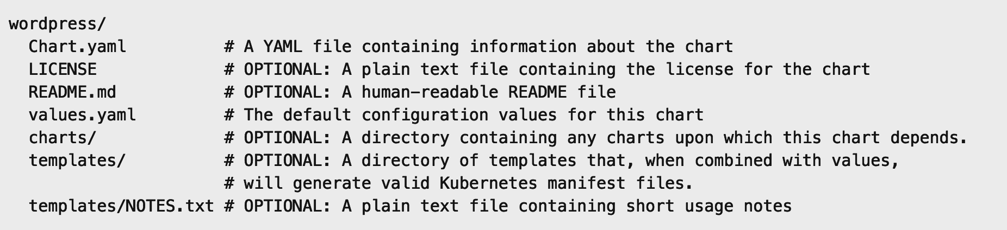
Chart structure
Layout
Helm expects a strict chart structure

Slide 82
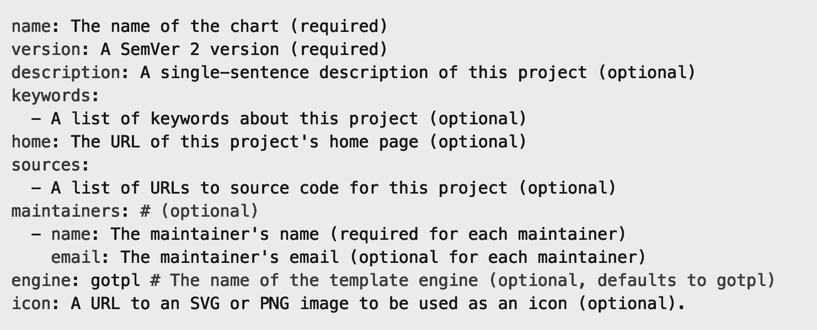
Chart.yaml

Slide 83
Helm values.yaml
The knobs and dials:
A values.yaml file provided with the chart that contains default values
Use -f to provide your own values overrides
Use --set to override individual values

Slide 84
Helm Templates
Built on Go’s template language w/addition of 50 or so add-on template functions
Almost anything goes! ;-)
Also useful in generating random values (e.g. passwords)
Provides flow control (if/else, with, range, etc)
Named templates (partials)

Slide 85
Open Service Broker for Azure
Connect Kubernetes apps to Azure simply and securely
Azure Database for MySQL
Azure Database for PostgreSQL
Azure SQL
Azure CosmosDB
Azure Redis
Azure Container Instances
Azure Service Bus
Azure Storage
More to come…
Built on an open standard
Integrated with Helm

Slide 86
Draft: Streamlined Kubernetes Development
What is draft?
Developer workstations cannot mimic production
As devs hack on code prior to committing to version control
Draft targets the "inner loop" of a developer's workflow
Works with other Deis tools such as Helm and Workflow
Developer Workstation
Dev (Inner Loop)
Production / Staging Cluster
Notes:
Draft is an open source tool.

Slide 87
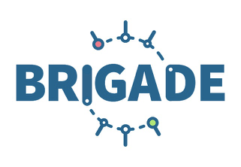
brigade: event-driven scripting for kubernetes
encapsulate functions in containers
run in parallel or serial
trigger workflow from Github, Docker registry, etc.
javascript (pipeline as code)
project config stored as secrets
well suited for CI/CD pipelines

Slide 88


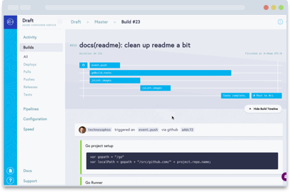
kashti: a dashboard for brigade projects
easy viewing and constructing brigade pipelines
waterfall diagram of brigade builds
view log output of build steps
quick peek at configuration for builds
Notes:
Hindi for kayak

Slide 89

Questions?

Slide 90








WHO WE ARE
www.architech.ca
kubernetes@architech.ca
Design. Build. Transform.
+
+
+
As a digital product studio, we enable digital transformation up to 87% faster.
13
100
300
years
people
projects
Notes:
What is a digital product studio? It’s a studio that combines capabilities - such as strategy, design, engineering and cognitive analytics – and talent to bring your product to life.
“The Digital Product Studio focuses on putting work of the highest possible quality and standard into the world.” https://blog.marvelapp.com/state-of-the-digital-nation-2016/#chapter-four-future-perspective
Select additional clients:
Bioventus
Canadian Tire
HVR
Loyalty One
Rogers
TMACC

Slide 91




LEGACY MODERNIZATION
DEDICATED TEAMS
PRODUCT INNOVATION
Migrate and rewrite applications to modern cloud architectures
Accelerate the delivery timelines of open source development projects
Lean product innovation from concept to MVP

Slide 92





DIGITAL PRODUCT STUDIO
Teams
Mastery Excellence
Integrated Collaborative
Skilled
Certified
Agile
Lean
Capabilities
Strategy + Design + Engineering + Cognitive Analytics
Methodology
Lean Startup + Design Thinking + Agile Engineering
Technology
Industry Proven | Lightweight | Open Source | Cloud-First
Partners
The right, quality solution, fast.
Notes:
Architech vocabulary should include the following:
Architech key words: fast, scalable, resilient, market-tested, agile, reliable
Application: industry proven, lightweight, open-source, developer productive
Platform: dynamic, programmable, elastic, faster, resilient, scalable, repeatable, consistent, on-demand
Cloud-Native: speed, scalable, resilient, pay for what you use, broad network access, reliable
Operations and analytics: enables monitoring, runtime visibility, rapid response, elastic
Security: free of vulnerabilities, responsive, monitor security events, testing
Digital transformation: empower, enable, transform, optimize, enhance, engage, data-drive, predictive, understand
Strategy - Strategy is based on strong validation. It begins with a deep understanding and empathy for your users combined with a number of proven tools and exercises to allow you to rapidly define a core value proposition, business model and product or service vision.
Design - Design brings ideas to life. We apply the best practice of human-centered design to create intelligent solutions that take your products to new heights.
CA - What don't you know that you would like to know? Cognitive analytics give us the unique ability to decipher patterns of behaviour from complex data, allowing us to solve problems previously thought impossible.
Engineering - We leverage engineering methodologies and technologies that enable focusing on what really matters, which is building great applications that are resilient, secure, and scalable, FAST.
What does it mean to be Agile?
What was missing in many of these organizations is the understanding that Agile is not just a “methodology”. Agile is only possible if you have the engineering capabilities and technologies to enable you to extract the collaborative power of these methodologies.
Our tech strategy:
Our technology strategy is devised to help our clients build secure, resilient solutions FAST. To ensure focus, mastery, and excellence, we categorize these technologies into 4 stacks: Application, Platform, Analytics, and Operations.
We leverage open-source, cloud native platforms to accelerate delivery and provide value to clients rapidly.
They are: industry leading, market tested, and proven to support applications at scale. We automate aggressively, from infrastructure, continuous integration/deployment, and runtime monitoring.
Our recommendation is dependent on the complexity of the app and client’s deployment environment. Sample platforms are: Openshift, Docker, Kurbernetes, and more.
Implementing our partner technologies helps clients yield up to a 30% increase in sales-generated revenue. Our Partners include Microsoft, dotCMS, and Redhat.
Our technology strategy is devised to help our clients build secure, resilient solutions FAST.
Microsoft:
System Integrator (SI) Partner
Silver Cloud Platform Competency
IoT & Advanced Analytics
Modern Application Development
Open Source
Two Time 2016 Microsoft IMPACT Award Winner
IoT Innovation
Open Source on Azure
DotCMS:
Only Platinum Partner in North America
Full service CMS migration strategies and development
RedHat:
Ready Business Partner
Exclusive Middleware Partner
Red Hat certified team and an official Red Hat subscription reseller

Slide 93

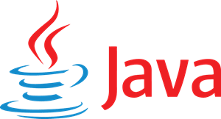
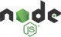

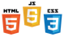









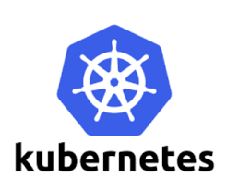

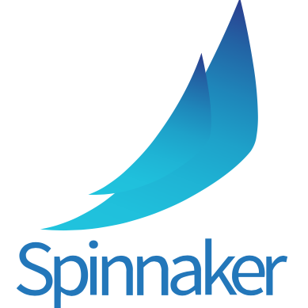





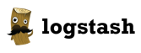

TECHNOLOGIES & PARTNERS
Application
Cognitive Analytics
DevOps CI/CD
Infrastructure
Platform
Operations & Support
Notes:
Our Solutions
We leverage open-source, cloud native platforms to accelerate delivery and provide value to clients rapidly. They are: industry leading, market tested, and proven to support applications at scale. We automate aggressively, from infrastructure, continuous integration/deployment, and runtime monitoring. Our recommendation is dependent on the complexity of the app and client’s deployment environment.
Technology to Enable Agile Engineering
What are the engineering practices and technologies that we employ to deliver resilient, scalable, secure, and easy to change solutions, fast? Well there are many, and to ensure focus, mastery, and excellence, we categorize them into 4 stacks.
Applications
We work with open-source frameworks that are industry proven, lightweight, and efficient technologies that help us deliver projects faster. They are productive to work with, fast, and scalable. Whether it is mobile, web, CMS, e-commerce, IoT, or the next great application you envision, we focus and leverage technologies that build great applications fast.
Platform
The platform technologies support the development, testing, and deployment of the applications we build, FAST. These technologies leverage the dynamic, programmable, elastic capabilities of the cloud to enable our application engineers to focus on building great applications. This stack enables:
Provisioning infrastructure in a repeatable, consistent manner on-demand.
Configured to be the same across all environments to avoid “configuration drift”.
Continuous integration and deployment of code verified through automated testing.
Analytics
The analytics stack and our Data Scientists unlock the data you have today to extract valuable insight. Data is key to driving the innovation cycle as it:
Provides state-of-the-art machine learning and deep learning algorithms
Scales to very large data sets and complex models through parallelization
Supports real time processing
Integrates with other open sources technologies
Operations
This stack extends to all three of Application, Platform and Analytics stacks.
It provides the runtime visibility into the solution to enable application monitoring, and rapid response to potential issues.
It creates standards and tools to enable teams to apply engineering practices such as:
Logs as an Event Stream
Capture applications and business metrics
Resilient and measureable MTTR operations
Quality ALWAYS visibility and mindset

